Slide 1
MACHINE LEARNING
Subject Code 19IS604 CIE Marks 50
Number of Lecture Hours/Week 03 SEE Marks 50
Total Number of Lecture Hours 39 Exam Hours 03

Slide 2
Course Outcomes
After studying this course, students will be able to
CO1 Summarize the core concepts of machine learning and feature engineering
CO2 Identify and apply supervised learning algorithms for appropriate classification problems
CO3 Experiment with Regression and unsupervised learning algorithms
CO4 Explain performance evaluation of machine learning algorithms
CO5 Identify and apply Artificial Neural Networks and ensemble modelling techniques to appropriate problems

Slide 3
References
TEXTBOOKS:
T.M. Mitchell, “Machine Learning”,Indian Edition, McGrawHill, 1997.
2. Miroslav Kubat ,“An Introduction to Machine Learning”, Second Edition
3. Ethem Alpaydin, “Introduction to Machine Learning”, Third Edition.
4. Andreas C Miller & Sarah Guido, “Introduction to Machine Learning with Python”,2018.
REFERENCE BOOKS:
R.O. Duda, P.E.Hart, and D.G.Stock, “Pattern Recognition”, Wiley Publications, 2001.
2. T. Hastie, R. Tibshirani, J. Friedman. “The Elements of Statistical Learning”, 2nd Edition, 2008.
3. P. Flach, “Machine Learning: The art and science of algorithms that make sense of data”, Cambridge University Press, 2012.
4.K. P. Murphy, “Machine Learning: A probabilistic Perspective”, MIT Press, 2012.
E-RESOURCES:
https://scikit-learn.org/stable/tutorial/basic/tutorial.html
2. https://scikit-learn.org/stable/
3. https://www.coursera.org/specializations/deep-learning

Slide 4
UNIT -1 Chapter-1

Slide 5
Introduction
Ever since computers were invented, we have wondered whether they might be made to learn. If we could understand how to program them to learn-to improve automatically with experience-the impact would be dramatic.
Imagine computers learning from medical records which treatments are most effective for new diseases
Houses learning from experience to optimize energy costs based on the particular usage patterns of their occupants.
Personal software assistants learning the evolving interests of their users in order to highlight especially relevant stories from the online morning newspaper

Slide 6
Examples of Successful Applications of Machine Learning
Learning to recognize spoken words
Learning to drive an autonomous vehicle
Learning to classify new astronomical structures
Learning to play world-class backgammon

Slide 7
Why is Machine Learning Important?
Some tasks cannot be defined well, except by examples (e.g., recognizing people).
Relationships and correlations can be hidden within large amounts of data. Machine Learning/Data Mining may be able to find these relationships.
Human designers often produce machines that do not work as well as desired in the environments in which they are used.
The amount of knowledge available about certain tasks might be too large for explicit encoding by humans (e.g., medical diagnostic).
Environments change over time.
New knowledge about tasks is constantly being discovered by humans. It may be difficult to continuously re-design systems “by hand”.

Slide 8
Areas of Influence for Machine Learning
Statistics: How best to use samples drawn from unknown probability distributions to help decide from which distribution some new sample is drawn?
Brain Models: Non-linear elements with weighted inputs (Artificial Neural Networks) have been suggested as simple models of biological neurons.
Adaptive Control Theory: How to deal with controlling a process having unknown parameters that must be estimated during operation?
Psychology: How to model human performance on various learning tasks?
Artificial Intelligence: How to write algorithms to acquire the knowledge humans are able to acquire, at least, as well as humans?
Evolutionary Models: How to model certain aspects of biological evolution to improve the performance of computer programs?

Slide 9
Machine Learning: A Definition
A computer program is said to learn from experience E with respect to some class of tasks T and performance measure P, if its performance at tasks in T, as measured by P, improves with experience E.

Slide 10
Why “Learn”?
Learning is used when:
Human expertise does not exist (navigating on Mars)
Humans are unable to explain their expertise (speech recognition)
Solution changes in time (routing on a computer network)
Solution needs to be adapted to particular cases (user biometrics)

Slide 11
Well-Posed Learning Problem
Definition: A computer program is said to learn from experience E with respect to some class of tasks T and performance measure P, if its performance at tasks in T, as measured by P, improves with experience E.
To have a well-defined learning problem, three features needs to be identified:
The class of tasks
The measure of performance to be improved
The source of experience

Slide 12
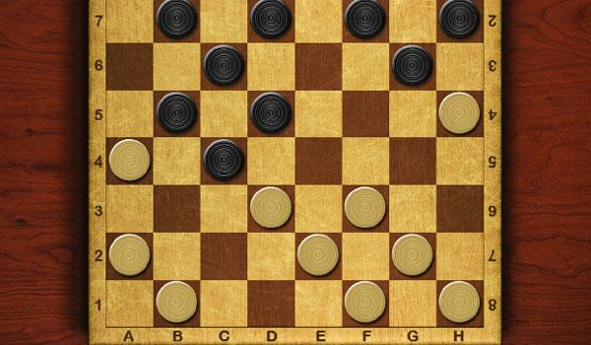
Checkers Game

Slide 13
Game Basics
Checkers is played by two players. Each player begins the game with 12 colored discs. (One set of pieces is black and the other red.) Each player places his or her pieces on the 12 dark squares closest to him or her. Black moves first. Players then alternate moves.
The board consists of 64 squares, alternating between 32 dark and 32 light squares.
It is positioned so that each player has a light square on the right side corner closest to him or her.
A player wins the game when the opponent cannot make a move. In most cases, this is because all of the opponent's pieces have been captured, but it could also be because all of his pieces are blocked in.

Slide 14
Rules of the Game
Moves are allowed only on the dark squares, so pieces always move diagonally. Single pieces are always limited to forward moves (toward the opponent).
A piece making a non-capturing move (not involving a jump) may move only one square.
A piece making a capturing move (a jump) leaps over one of the opponent's pieces, landing in a straight diagonal line on the other side. Only one piece may be captured in a single jump; however, multiple jumps are allowed during a single turn.
When a piece is captured, it is removed from the board.
If a player is able to make a capture, there is no option; the jump must be made.
If more than one capture is available, the player is free to choose whichever he or she prefers.

Slide 15
Rules of the Game Cont.
When a piece reaches the furthest row from the player who controls that piece, it is crowned and becomes a king. One of the pieces which had been captured is placed on top of the king so that it is twice as high as a single piece.
Kings are limited to moving diagonally but may move both forward and backward. (Remember that single pieces, i.e. non-kings, are always limited to forward moves.)
Kings may combine jumps in several directions, forward and backward, on the same turn. Single pieces may shift direction diagonally during a multiple capture turn, but must always jump forward (toward the opponent).

Slide 16
Well-Defined Learning Problem
A checkers learning problem:
Task T: playing checkers
Performance measure P: percent of games won against opponents
Training experience E: playing practice games against itself
A handwriting recognition learning problem:
Task T: recognizing and classifying handwritten words within images
Performance measure P: percent of words correctly classified
Training experience E: a database of handwritten words with given classifications

Slide 17
A robot driving learning problem:
Task T: driving on public four-lane highways using vision sensors
Performance measure P: average distance travelled before an error (as judged by human overseer)
Training experience E: a sequence of images and steering commands recorded while observing a human driver

Slide 18
Designing a Learning System
1. Choosing the Training Experience
2. Choosing the Target Function
3. Choosing a Representation for the Target Function
4. Choosing a Function Approximation Algorithm
1. Estimating training values
2. Adjusting the weights
5. The Final Design

Slide 19
The basic design issues and approaches to machine learning is illustrated by considering designing a program to learn to play checkers, with the goal of entering it in the world checkers tournament

Slide 20
1. Choosing the Training Experience
The first design choice is to choose the type of training experience from which the system will learn.
The type of training experience available can have a significant impact on success or failure of the learner.
There are three attributes which impact on success or failure of the learner
Whether the training experience provides direct or indirect feedback regarding the choices made by the performance system.
The degree to which the learner controls the sequence of training examples
How well it represents the distribution of examples over which the final system performance P must be measured.

Slide 21
1. Whether the training experience provides direct or indirect feedback regarding the choices made by the performance system.
For example, in checkers game:
In learning to play checkers, the system might learn from direct training examples consisting of individual checkers board states and the correct move for each.
Indirect training examples consisting of the move sequences and final outcomes of various games played.
The information about the correctness of specific moves early in the game must be inferred indirectly from the fact that the game was eventually won or lost.
Here the learner faces an additional problem of credit assignment, or determining the degree to which each move in the sequence deserves credit or blame for the final outcome.
Credit assignment can be a particularly difficult problem because the game can be lost even when early moves are optimal, if these are followed later by poor moves.
Hence, learning from direct training feedback is typically easier than learning from indirect feedback.

Slide 22
2. A second important attribute of the training experience is the degree to which the learner controls the sequence of training examples
For example, in checkers game:
The learner might depends on the teacher to select informative board states and to provide the correct move for each.
Alternatively, the learner might itself propose board states that it finds particularly confusing and ask the teacher for the correct move.
The learner may have complete control over both the board states and (indirect) training classifications, as it does when it learns by playing against itself with no teacher present.
Notice in this last case the learner may choose between experimenting with novel board states that it has not yet considered, or honing its skill by playing minor variations of lines of play it currently finds most promising.

Slide 23
3. A third attribute of the training experience is how well it represents the distribution of examples over which the final system performance P must be measured.
Learning is most reliable when the training examples follow a distribution similar to that of future test examples.
For example, in checkers game:
In checkers learning scenario, the performance metric P is the percent of games the system wins in the world tournament.
If its training experience E consists only of games played against itself, there is an danger that this training experience might not be fully representative of the distribution of situations over which it will later be tested. For example, the learner might never encounter certain crucial board states that are very likely to be played by the human checkers champion.
It is necessary to learn from a distribution of examples that is somewhat different from those on which the final system will be evaluated. Such situations are problematic because mastery of one distribution of examples will not necessary lead to strong performance over some other distribution.

Slide 24
2. Choosing the Target Function
The next design choice is to determine exactly what type of knowledge will be learned and how this will be used by the performance program.
Lets begin with a checkers-playing program that can generate the legal moves from any board state.
The program needs only to learn how to choose the best move from among these legal moves. This learning task is representative of a large class of tasks for which the legal moves that define some large search space are known a priori, but for which the best search strategy is not known.

Slide 25
Given this setting where we must learn to choose among the legal moves, the most obvious choice for the type of information to be learned is a program, or function, that chooses the best move for any given board state.
1. Let ChooseMove be the target function and the notation is
ChooseMove : B M
which indicate that this function accepts as input any board from the set of legal board states B and produces as output some move from the set of legal moves M.
ChooseMove is an choice for the target function in checkers example, but this function will turn out to be very difficult to learn given the kind of indirect training experience available to our system

Slide 26
2. An alternative target function is an evaluation function that assigns a numerical score to any given board state
Let the target function V and the notation
V : B R
which denote that V maps any legal board state from the set B to some real value
We intend for this target function V to assign higher scores to better board states. If the system can successfully learn such a target function V, then it can easily use it to select the best move from any current board position.

Slide 27
Let us define the target value V(b) for an arbitrary board state b in B, as follows:
if b is a final board state that is won, then V(b) = 100
if b is a final board state that is lost, then V(b) = -100
if b is a final board state that is drawn, then V(b) = 0
if b is a not a final state in the game, then V(b) = V(b' ),
where b' is the best final board state that can be achieved starting from b and playing optimally until the end of the game

Slide 28
3. Choosing a Representation for the Target Function
let us choose a simple representation - for any given board state, the function Ṽ will be calculated as a linear combination of the following board features:
xl: the number of black pieces on the board
x2: the number of red pieces on the board
x3: the number of black kings on the board
x4: the number of red kings on the board
x5: the number of black pieces threatened by red (i.e., which can be
captured on red's next turn)
x6: the number of red pieces threatened by black

Slide 29
Thus, learning program will represent as a linear function of the form
Where,
w₀ through w₆ are numerical coefficients, or weights, to be chosen by the learning algorithm.
Learned values for the weights w₁ through w₆ will determine the relative importance of the various board features in determining the value of the board
The weight w₀ will provide an additive constant to the board value

Slide 30
Partial design of a checkers learning program:
Task T: playing checkers
Performance measure P: percent of games won in the world tournament
Training experience E: games played against itself
Target function: V: Board R
Target function representation
The first three items above correspond to the specification of the learning task,
whereas the final two items constitute design choices for the implementation of the learning program.

Slide 31
4. Choosing a Function Approximation Algorithm
In order to learn the target function f we require a set of training examples, each describing a specific board state b and the training value V_{train}(b) for b.
Each training example is an ordered pair of the form (b, V_{train}(b)).
For instance, the following training example describes a board state b in which black has won the game (note x₂ = 0 indicates that red has no remaining pieces) and for which the target function value V_{train}(b) is therefore +100.
((x₁=3, x₂=0, x₃=1, x₄=0, x₅=0, x₆=0), +100)

Slide 32
Function Approximation Procedure
Derive training examples from the indirect training experience available to the learner
Adjusts the weights w_{i} to best fit these training examples

Slide 33
1. Estimating training values
A simple approach for estimating training values for intermediate board states is to assign the training value of V_{train}(b) for any intermediate board state b to be V̂(Successor(b))
Where ,
V̂ is the learner's current approximation to V
Successor(b) denotes the next board state following b for which it is again the program's turn to move
Rule for estimating training values
V_{train}(b) ← V̂ (Successor(b))

Slide 34
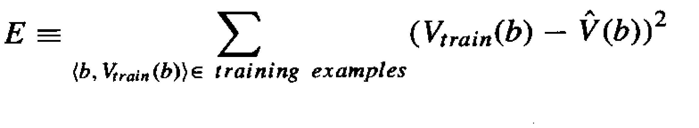
2. Adjusting the weights
Specify the learning algorithm for choosing the weights w_{i} to best fit the set of training examples {(b, V_{train}(b))}
A first step is to define what we mean by the bestfit to the training data.
One common approach is to define the best hypothesis, or set of weights, as that which minimizes the squared error E between the training values and the values predicted by the hypothesis.
Several algorithms are known for finding weights of a linear function that minimize E.

Slide 35
In our case, we require an algorithm that will incrementally refine the weights as new training examples become available and that will be robust to errors in these estimated training values
One such algorithm is called the least mean squares, or LMS training rule. For each observed training example it adjusts the weights a small amount in the direction that reduces the error on this training example
LMS weight update rule :- For each training example (b, V_{train}(b))
Use the current weights to calculate V̂ (b)
For each weight w_{i}, update it as
w_{i} ← w_{i} + ƞ (Vtrain (b) - V̂(b)) x_{i}

Slide 36
Here ƞ is a small constant (e.g., 0.1) that moderates the size of the weight update.
Working of weight update rule
When the error (Vtrain(b)- V̂(b)) is zero, no weights are changed.
When (Vtrain(b) - V̂(b)) is positive (i.e., when V̂(b) is too low), then each weight is increased in proportion to the value of its corresponding feature. This will raise the value of V̂(b), reducing the error.
If the value of some feature x_{i} is zero, then its weight is not altered regardless of the error, so that the only weights updated are those whose features actually occur on the training example board.

Slide 37
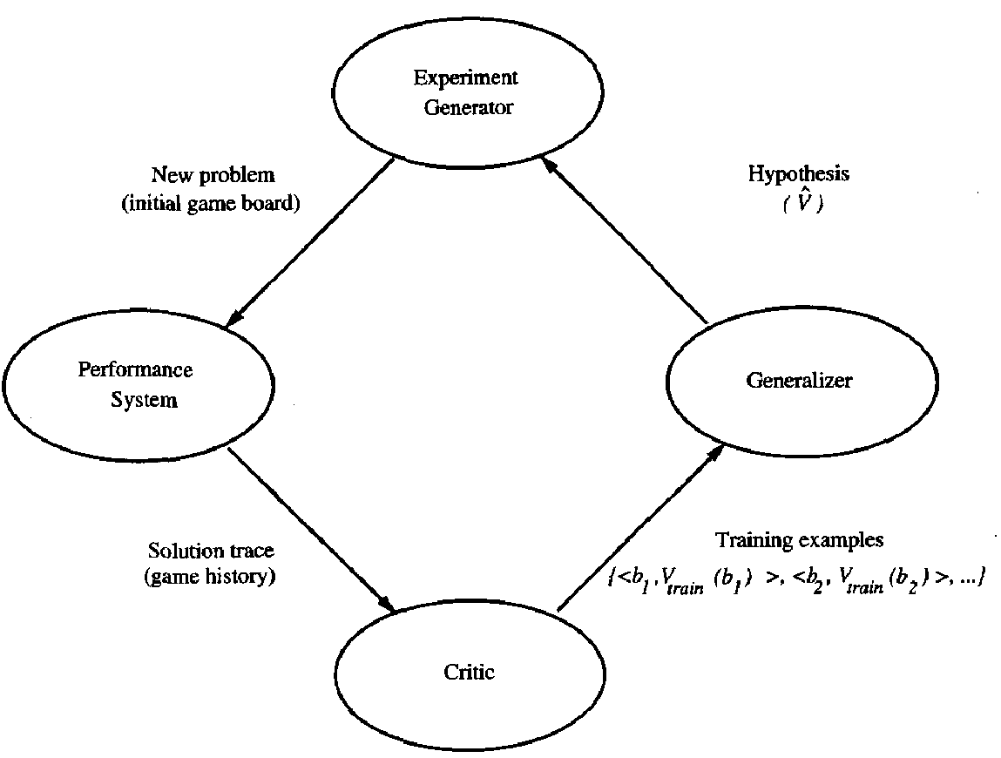
5. The Final Design
The final design of checkers learning system can be described by four distinct program modules that represent the central components in many learning systems

Slide 38
1. The Performance System is the module that must solve the given performance
task by using the learned target function(s).
It takes an instance of a new problem (new game) as input and produces a trace of its solution (game history) as output.
In checkers game, the strategy used by the Performance System to select its next move at each step is determined by the learned V̂ evaluation function. Therefore, we expect its performance to improve as this evaluation function becomes increasingly accurate.
2. The Critic takes as input the history or trace of the game and produces as output a set of training examples of the target function. As shown in the diagram, each training example in this case corresponds to some game state in the trace, along with an estimate V_{train} of the target function value for this example.

Slide 39
3. The Generalizer takes as input the training examples and produces an output
hypothesis that is its estimate of the target function.
It generalizes from the specific training examples, hypothesizing a general function that covers these examples and other cases beyond the training examples.
In our example, the Generalizer corresponds to the LMS algorithm, and the output hypothesis is the function V̂ described by the learned weights w₀, . . . , W₆.
4. The Experiment Generator takes as input the current hypothesis and outputs a new problem (i.e., initial board state) for the Performance System to explore. Its role is to pick new practice problems that will maximize the learning rate of the overall system.
In our example, the Experiment Generator always proposes the same initial game board to begin a new game.

Slide 40
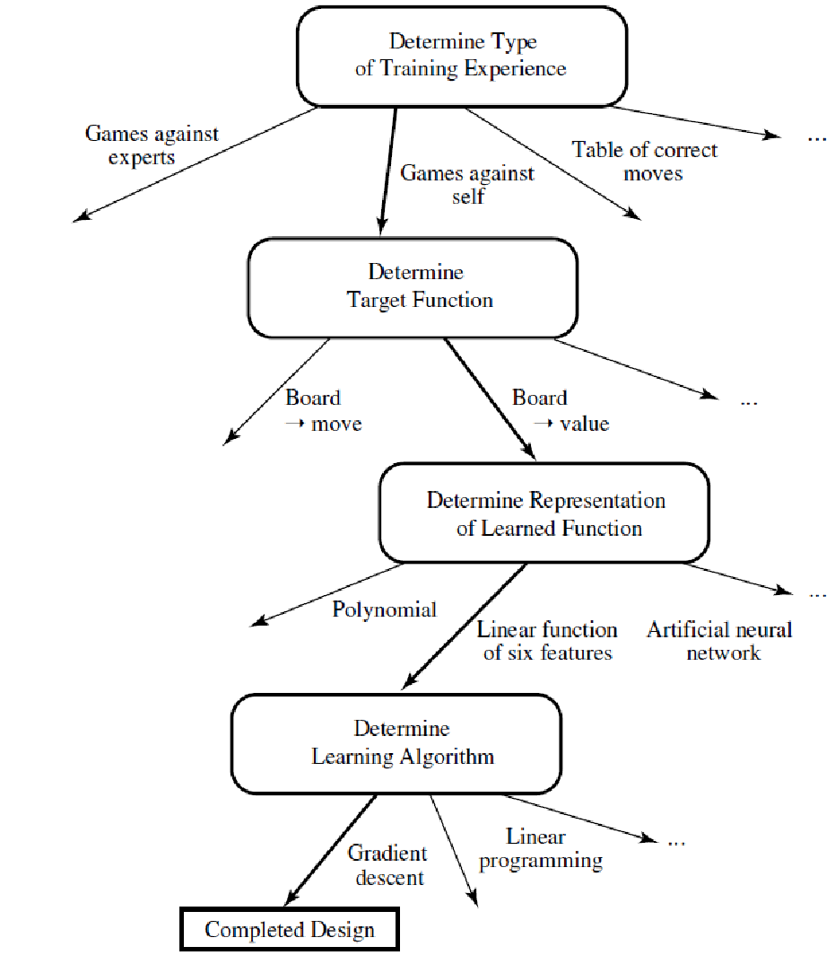
The sequence of design choices made for the checkers program is summarized in below figure

Slide 41
Issues in Machine Learning
What algorithms exist for learning general target functions from specific training examples? In what settings will particular algorithms converge to the desired function, given sufficient training data? Which algorithms perform best for which types of problems and representations?
How much training data is sufficient? What general bounds can be found to relate the confidence in learned hypotheses to the amount of training experience and the character of the learner's hypothesis space?
When and how can prior knowledge held by the learner guide the process of generalizing from examples? Can prior knowledge be helpful even when it is only approximately correct?

Slide 42
What is the best strategy for choosing a useful next training experience, and how does the choice of this strategy alter the complexity of the learning problem?
What is the best way to reduce the learning task to one or more function approximation problems? Put another way, what specific functions should the system attempt to learn? Can this process itself be automated?
How can the learner automatically alter its representation to improve its ability to represent and learn the target function?

Slide 43
MODULE -1 Chapter-2

Slide 44
Concept Learning
Learning involves acquiring general concepts from specific training examples. Example: People continually learn general concepts or categories such as "bird," "car," "situations in which I should study more in order to pass the exam," etc.
Each such concept can be viewed as describing some subset of objects or events defined over a larger set
Alternatively, each concept can be thought of as a Boolean-valued function defined over this larger set. (Example: A function defined over all animals, whose value is true for birds and false for other animals).
Concept learning - Inferring a Boolean-valued function from training examples of its input and output

Slide 45
A Concept Learning Task
Consider the example task of learning the target concept
"Days on which my friend Aldo enjoys his favorite water sport."
Table- Describes a set of example days, each represented by a set of attributes
Example | Sky | AirTemp | Humidity | Wind | Water | Forecast | EnjoySport
1 | Sunny | Warm | Normal | Strong | Warm | Same | Yes
2 | Sunny | Warm | High | Strong | Warm | Same | Yes
3 | Rainy | Cold | High | Strong | Warm | Change | No
4 | Sunny | Warm | High | Strong | Cool | Change | Yes

Slide 46
The attribute EnjoySport indicates whether or not a Person enjoys his favorite water sport on this day.
The task is to learn to predict the value of EnjoySport for an arbitrary day, based on the values of its other attributes ?

Slide 47
What hypothesis representation is provided to the learner?
A model that approximates the target function and performs mappings of inputs to outputs is called a hypothesis in machine learning.
Let’s consider a simple representation in which each hypothesis consists of a conjunction of constraints on the instance attributes.
Let each hypothesis be a vector of six constraints, specifying the values of the six attributes Sky, AirTemp, Humidity, Wind, Water, and Forecast.
For each attribute, the hypothesis will either
Indicate by a "?' that any value is acceptable for this attribute,
Specify a single required value (e.g., Warm) for the attribute, or
Indicate by a "Φ" that no value is acceptable

Slide 48
If some instance x satisfies all the constraints of hypothesis h, then h classifies
x as a positive example (h(x) = 1).
The hypothesis that PERSON enjoys his favorite sport only on cold days with high humidity (independent of the values of the other attributes) is represented by the expression
(?, Cold, High, ?, ?, ?)
The most general hypothesis-that every day is a positive example-is represented by
(?, ?, ?, ?, ?, ?)
The most specific possible hypothesis-that no day is a positive example-is represented by
(Φ , Φ, Φ, Φ, Φ, Φ)

Slide 49
Notation
The set of items over which the concept is defined is called the set of instances, which we denote by X.
Example: X is the set of all possible days, each represented by the attributes: Sky, AirTemp, Humidity, Wind, Water, and Forecast
The concept or function to be learned is called the target concept, which we denote by c.
c can be any Boolean valued function defined over the instances X
c : X {O, 1}
Example: The target concept corresponds to the value of the attribute EnjoySport (i.e., c(x) = 1 if EnjoySport = Yes, and c(x) = 0 if EnjoySport = No).

Slide 50
Instances for which c(x) = 1 are called positive examples, or members of the target concept.
Instances for which c(x) = 0 are called negative examples, or non-members of the target concept.
The ordered pair (x, c(x)) to describe the training example consisting of the instance x and its target concept value c(x).
D to denote the set of available training examples
The symbol H to denote the set of all possible hypotheses that the learner may consider regarding the identity of the target concept. Each hypothesis h in H represents a Boolean-valued function defined over X
h : X {O, 1}
The goal of the learner is to find a hypothesis h such that h(x) = c(x) for all x in X.

Slide 51
Example | Sky | AirTemp | Humidity | Wind | Water | Forecast | EnjoySport
1 | Sunny | Warm | Normal | Strong | Warm | Same | Yes
2 | Sunny | Warm | High | Strong | Warm | Same | Yes
3 | Rainy | Cold | High | Strong | Warm | Change | No
4 | Sunny | Warm | High | Strong | Cool | Change | Yes

Slide 52
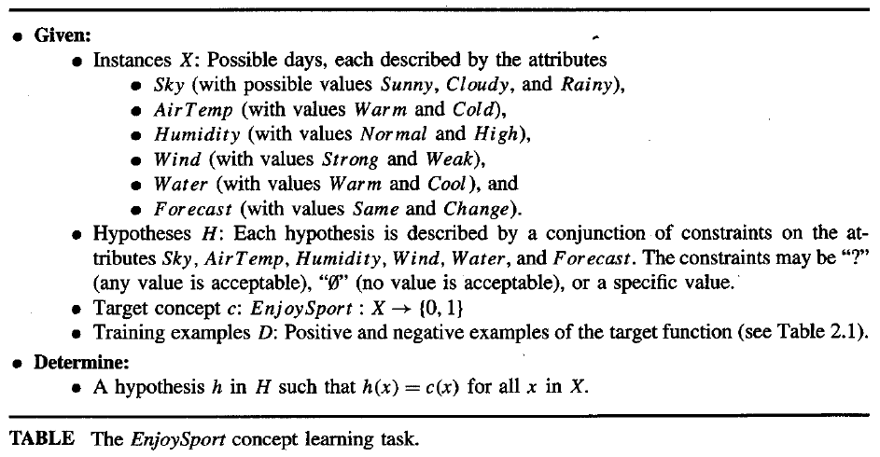

Slide 53
The Inductive Learning Hypothesis
Any hypothesis found to approximate the target function well over a sufficiently large set of training examples will also approximate the target function well over other unobserved examples.

Slide 54
Concept learning as Search
Concept learning can be viewed as the task of searching through a large space of hypotheses implicitly defined by the hypothesis representation.
The goal of this search is to find the hypothesis that best fits the training examples.
Example, the instances X and hypotheses H in the EnjoySport learning task.
The attribute Sky has three possible values, and AirTemp, Humidity, Wind, Water
Forecast each have two possible values, the instance space X contains exactly
3.2.2.2.2.2 = 96 Distinct instances
5.4.4.4.4.4 = 5120 Syntactically distinct hypotheses within H.
Every hypothesis containing one or more " Φ" symbols represents the empty set of instances; that is, it classifies every instance as negative.
1 + (4.3.3.3.3.3) = 973. Semantically distinct hypotheses

Slide 55
General-to-Specific Ordering of Hypotheses
Consider the two hypotheses
h₁ = (Sunny, ?, ?, Strong, ?, ?)
h₂ = (Sunny, ?, ?, ?, ?, ?)
Consider the sets of instances that are classified positive by h_{l} and by h₂.
h₂ imposes fewer constraints on the instance, it classifies more instances as positive. So, any instance classified positive by h_{l} will also be classified positive by h₂. Therefore, h₂ is more general than h_{l}.

Slide 56
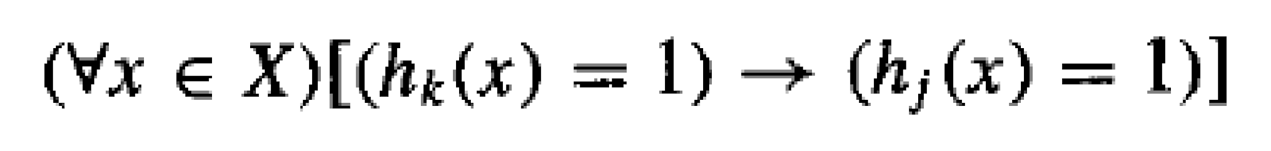
General-to-Specific Ordering of Hypotheses
Given hypotheses h_{j} and h_{k}, h_{j} is more-general-than or- equal to h_{k} if and only if any instance that satisfies h_{k} also satisfies h_{j}
Definition: Let h_{j} and h_{k} be Boolean-valued functions defined over X. Then h_{j} is more general-than-or-equal-to h_{k} (written h_{j} ≥ h_{k}) if and only if

Slide 57
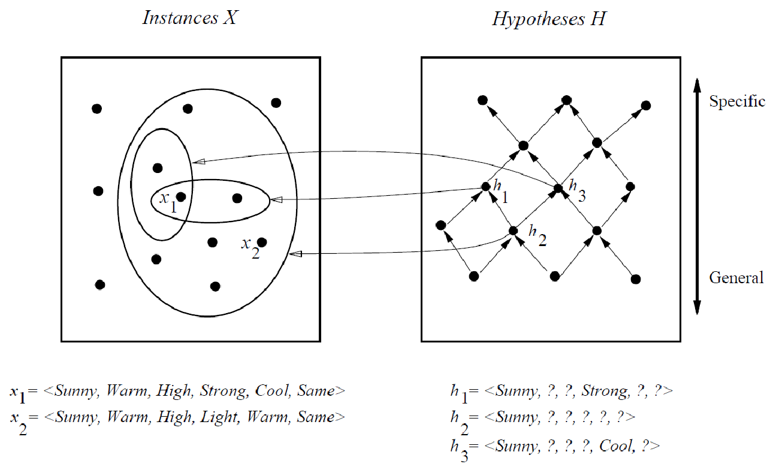
In the figure, the box on the left represents the set X of all instances, the box on the right the set H of all hypotheses.
Each hypothesis corresponds to some subset of X-the subset of instances that it classifies positive.
The arrows connecting hypotheses represent the more - general -than relation, with the arrow pointing toward the less general hypothesis.
Note the subset of instances characterized by h₂ subsumes the subset characterized by h _{l} , hence h₂ is more - general– than h₁

Slide 58
FIND-S: Finding a Maximally Specific Hypothesis
FIND-S Algorithm
1. Initialize h to the most specific hypothesis in H
2. For each positive training instance x
For each attribute constraint a_{i} in h
If the constraint a_{i} is satisfied by x
Then do nothing
Else replace a_{i} in h by the next more general constraint that is satisfied by x
3. Output hypothesis h

Slide 59
To illustrate this algorithm, assume the learner is given the sequence of training examples from the EnjoySport task
The first step of FIND-S is to initialize h to the most specific hypothesis in H
h - (Ø, Ø, Ø, Ø, Ø, Ø)
Example | Sky | AirTemp | Humidity | Wind | Water | Forecast | EnjoySport
1 | Sunny | Warm | Normal | Strong | Warm | Same | Yes
2 | Sunny | Warm | High | Strong | Warm | Same | Yes
3 | Rainy | Cold | High | Strong | Warm | Change | No
4 | Sunny | Warm | High | Strong | Cool | Change | Yes

Slide 60
x₁ = <Sunny Warm Normal Strong Warm Same>, +
Observing the first training example, it is clear that our hypothesis is too specific. In particular, none of the "Ø" constraints in h are satisfied by this example, so each is replaced by the next more general constraint that fits the example
h₁ = <Sunny Warm Normal Strong Warm Same>
This h is still very specific; it asserts that all instances are negative except for the single positive training example
x₂ = <Sunny, Warm, High, Strong, Warm, Same>, +
The second training example forces the algorithm to further generalize h, this time substituting a "?' in place of any attribute value in h that is not satisfied by the new example
h₂ = <Sunny Warm ? Strong Warm Same>

Slide 61
x3 = <Rainy, Cold, High, Strong, Warm, Change>, -
Upon encountering the third training the algorithm makes no change to h. The FIND-S algorithm simply ignores every negative example.
h3 = < Sunny Warm ? Strong Warm Same>
x4 = <Sunny Warm High Strong Cool Change>, +
The fourth example leads to a further generalization of h
h4 = < Sunny Warm ? Strong ? ? >

Slide 62
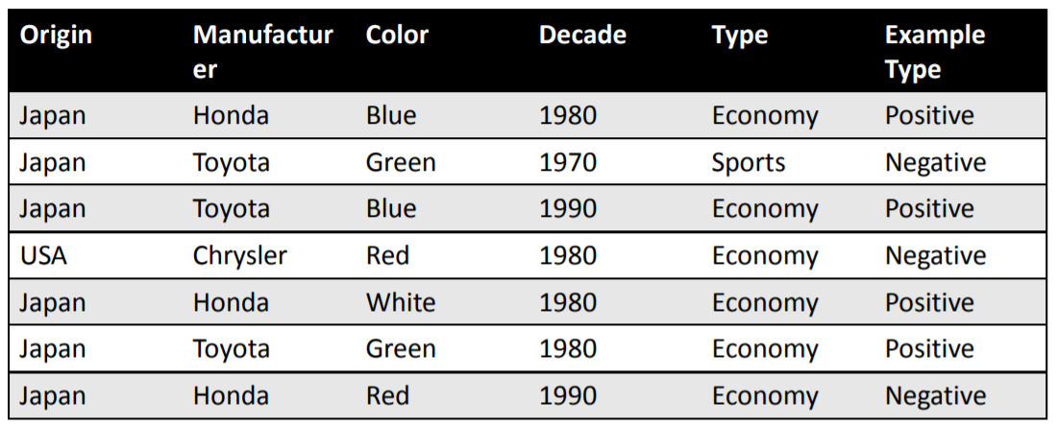

Slide 63
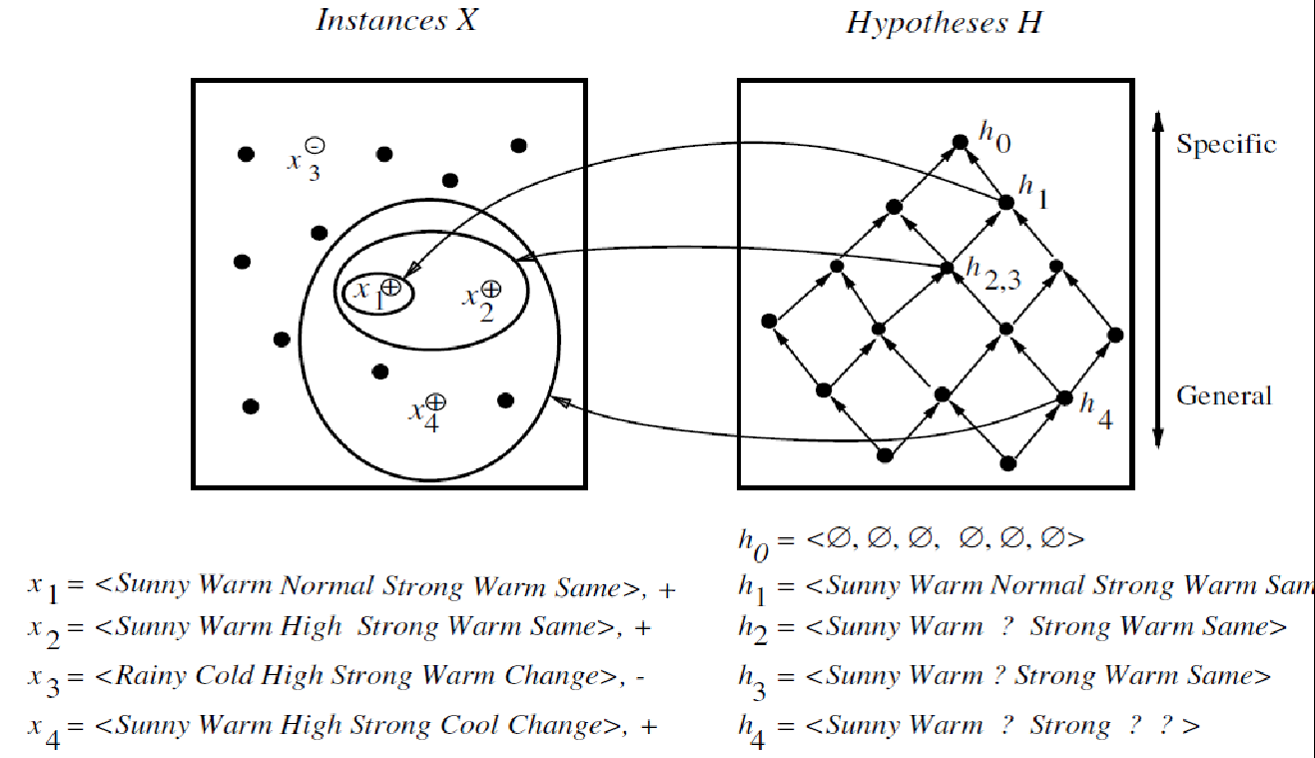

Slide 64
The key property of the FIND-S algorithm is
FIND-S is guaranteed to output the most specific hypothesis within H that is consistent with the positive training examples
FIND-S algorithm’s final hypothesis will also be consistent with the negative examples provided the correct target concept is contained in H, and provided the training examples are correct.

Slide 65
Unanswered by FIND-S
Has the learner converged to the correct target concept?
Why prefer the most specific hypothesis?
Are the training examples consistent?
What if there are several maximally specific consistent hypotheses?

Slide 66
Version Space
A version space is a hierarchial representation of knowledge that enables you to keep track of all the useful information supplied by a sequence of learning examples without remembering any of the examples.
The version space method is a concept learning process accomplished by managing multiple models within a version space.
Version Space Characteristics
Tentative heuristics are represented using version spaces.
A version space represents all the alternative plausible descriptions of a heuristic. A plausible description is one that is applicable to all known positive examples and no known negative example.
A version space description consists of two complementary trees:
One that contains nodes connected to overly general models, and
One that contains nodes connected to overly specific models.
Node values/attributes are discrete.

Slide 67
Version Space
Fundamental Assumptions
The data is correct; there are no erroneous instances.
A correct description is a conjunction of some of the attributes with values.
Diagrammatical Guidelines
There is a generalization tree and a specialization tree.
Each node is connected to a model.
Nodes in the generalization tree are connected to a model that matches everything in its subtree.
Nodes in the specialization tree are connected to a model that matches only one thing in its subtree.
Links between nodes and their models denote
generalization relations in a generalization tree, and
specialization relations in a specialization tree.

Slide 68
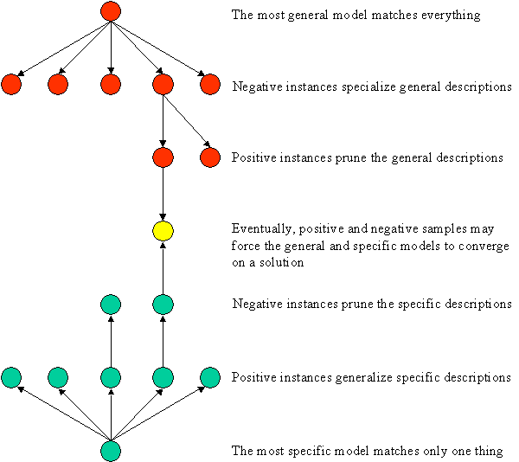
Version Space Diagram
In the diagram below, the specialization tree is colored red, and the generalization tree is colored green

Slide 69
Version Space and CANDIDATE ELIMINATION Algorithm
The key idea in the CANDIDATE-ELIMINATION algorithm is to output a description of the set of all hypothesis consistent with the training examples
Representation
Definition: A hypothesis h is consistent with a set of training examples D if and only if h(x) = c(x) for each example (x, c(x)) in D.
Consistent(h, D) ≡ (∀ 〈x, c(x)〉 ∈ D) h(x) = c(x))
Note difference between definitions of consistent and satisfies
an example x is said to satisfy hypothesis h when h(x) = 1, regardless of whether x is a positive or negative example of the target concept.
an example x is said to consistent with hypothesis h iff h(x) = c(x)

Slide 70
Version Space
A representation of the set of all hypotheses which are consistent with D
Definition: The version space, denoted VS_{H,D} with respect to hypothesis space H and training examples D, is the subset of hypotheses from H consistent with the training examples in D
VS_{H,D} ≡{h ∈ H | Consistent(h, D)}

Slide 71
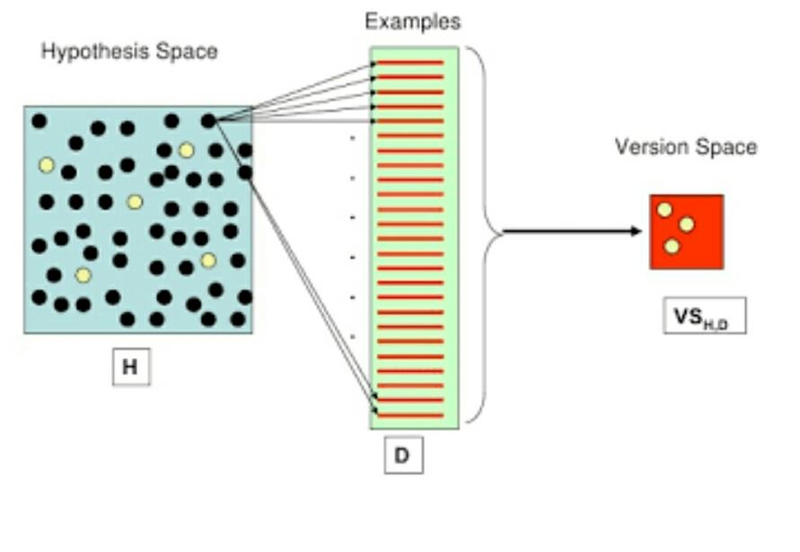

Slide 72
The LIST-THEN-ELIMINATE Algorithm
The LIST-THEN-ELIMINATE algorithm first initializes the version space to contain all hypotheses in H and then eliminates any hypothesis found inconsistent with any training example.

Slide 73
The LIST-THEN-ELIMINATE Algorithm
1. VersionSpace c a list containing every hypothesis in H
2. For each training example, (x, c(x))
remove from VersionSpace any hypothesis h for which h(x) ≠ c(x)
3. Output the list of hypotheses in VersionSpace
The LIST-THEN-ELIMINATE Algorithm
List-Then-Eliminate works in principle, so long as version space is finite.
However, since it requires exhaustive enumeration of all hypotheses in practice it is not feasible.

Slide 74
A More Compact Representation for Version Spaces
The version space is represented by its most general and least general members.
These members form general and specific boundary sets that delimit the version space within the partially ordered hypothesis space.

Slide 75
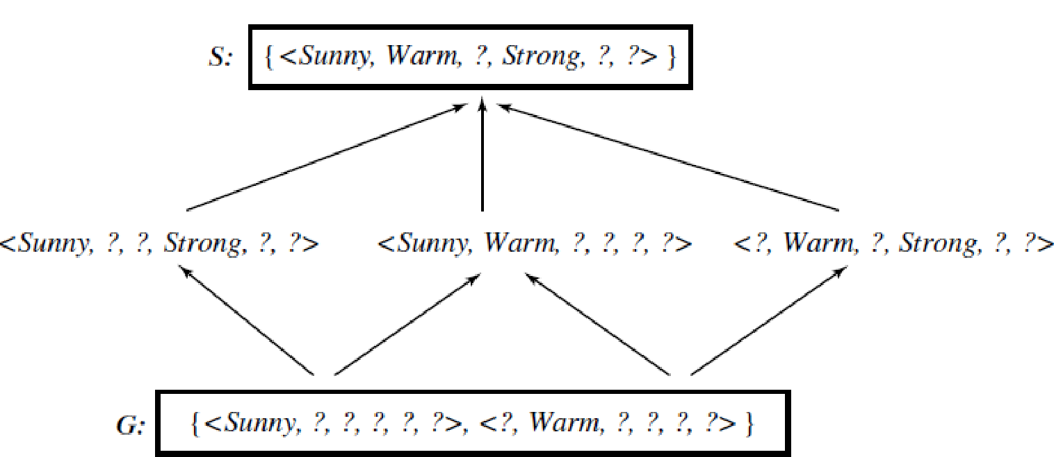
A version space with its general and specific boundary sets.
The version space includes all six hypotheses shown here, but can be represented more simply by S and G.
Arrows indicate instance of the more-general-than relation. This is the version space for the Enjoysport concept learning
problem and training examples described in below table
Example | Sky | AirTemp | Humidity | Wind | Water | Forecast | EnjoySport
1 | Sunny | Warm | Normal | Strong | Warm | Same | Yes
2 | Sunny | Warm | High | Strong | Warm | Same | Yes
3 | Rainy | Cold | High | Strong | Warm | Change | No
4 | Sunny | Warm | High | Strong | Cool | Change | Yes

Slide 76
Definition: The general boundary G, with respect to hypothesis space H and training data D, is the set of maximally general members of H consistent with D
G ≡{g ∈ H | Consistent(g, D)∧(¬∃g' ∈ H)[(g' >_{g} g) ∧ Consistent(g', D)]}
Definition: The specific boundary S, with respect to hypothesis space H and training data D, is the set of minimally general (i.e., maximally specific) members of H consistent with D.
S ≡{s ∈ H | Consistent(s, D)∧(¬∃s' ∈ H)[(s >_{g}s') ∧ Consistent(s', D)]}

Slide 77
Version Space representation theorem
Theorem: Let X be an arbitrary set of instances and Let H be a set of Boolean-valued hypotheses defined over X. Let c : X →{O, 1} be an arbitrary target concept defined over X, and let D be an arbitrary set of training examples {(x, c(x))). For all X, H, c, and D such that S and G are well defined,
VS_{H,D}={h ∈ H |(∃s ∈ S) (∃g ∈ G) (g ≥_{g} h ≥_{g} s)}

Slide 78
VS_{H,D}={h ∈ H |(∃s ∈ S) (∃g ∈ G) (g ≥_{g} h ≥_{g} s)}
To Prove:
1. Every h satisfying the right hand side of the above expression is in VS _{H,D}
2. Every member of VS _{H,D} satisfies the right-hand side of the expression
Sketch of proof:
let g, h, s be arbitrary members of G, H, S respectively with g ≥_{g} h ≥_{g} s
By the definition of S, s must be satisfied by all positive examples in D. Because h ≥_{g} s , h must also be satisfied by all positive examples in D.
By the definition of G, g cannot be satisfied by any negative example in D, and because g ≥_{g} h h cannot be satisfied by any negative example in D. Because h is satisfied by all positive examples in D and by no negative examples in D, h is consistent with D, and therefore h is a member of VS_{H,D}
2. It can be proven by assuming some h in VS_{H,D},that does not satisfy the right-hand side of the expression, then showing that this leads to an inconsistency

Slide 79
The CANDIDATE-ELIMINATION Learning Algorithm
The CANDIDATE-ELIMINTION algorithm computes the version space containing all hypotheses from H that are consistent with an observed sequence of training examples.

Slide 80
Initialize G to the set of maximally general hypotheses in H
Initialize S to the set of maximally specific hypotheses in H
For each training example d, do
If d is a positive example
Remove from G any hypothesis inconsistent with d
For each hypothesis s in S that is not consistent with d
Remove s from S
Add to S all minimal generalizations h of s such that
h is consistent with d, and some member of G is more general than h
Remove from S any hypothesis that is more general than another hypothesis in S
If d is a negative example
Remove from S any hypothesis inconsistent with d
For each hypothesis g in G that is not consistent with d
Remove g from G
Add to G all minimal specializations h of g such that
h is consistent with d, and some member of S is more specific than h
Remove from G any hypothesis that is less general than another hypothesis in G

Slide 81
An Illustrative Example
The boundary sets are first initialized to G_{o} and S_{o}, the most general and most specific hypotheses in H.
S₀
〈∅, ∅, ∅, ∅, ∅, ∅〉
G₀
〈?, ?, ?, ?, ?, ?〉

Slide 82
For training example d,
〈Sunny, Warm, Normal, Strong, Warm, Same 〉 +
S₀
〈∅, ∅, ∅, ∅, ∅. ∅〉
S₁
〈Sunny, Warm, Normal, Strong, Warm, Same〉
G₀, G₁
〈?, ?, ?, ?, ?, ?〉

Slide 83
For training example d,
〈Sunny, Warm, High, Strong, Warm, Same〉 +
S₁
〈Sunny, Warm, Normal, Strong, Warm, Same〉
S₂
〈Sunny, Warm, ?, Strong, Warm, Same〉
G₁, G₂
〈?, ?, ?, ?, ?, ?〉

Slide 84
For training example d,
〈Rainy, Cold, High, Strong, Warm, Change 〉 −
S_{2,} S₃
〈Sunny, Warm, ?, Strong, Warm, Same〉
G₃
〈Sunny, ?, ?, ?, ?, ?〉 〈?, Warm, ?, ?, ?, ?〉 〈?, ?, ?, ?, ?, Same〉
G₂
〈?, ?, ?, ?, ?, ?〉

Slide 85
For training example d,
〈Sunny, Warm, High, Strong, Cool Change 〉 +
S₃
〈Sunny, Warm, ?, Strong, Warm, Same〉
S₄
〈Sunny, Warm, ?, Strong, ?, ?〉
G₄
〈Sunny, ?, ?, ?, ?, ?〉 〈?, Warm, ?, ?, ?, ?〉
G₃
〈Sunny, ?, ?, ?, ?, ?〉 〈?, Warm, ?, ?, ?, ?〉 〈?, ?, ?, ?, ?, Same〉

Slide 86
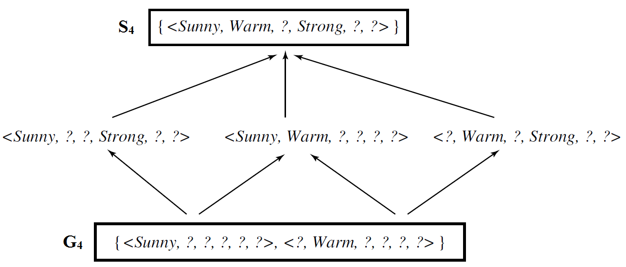
The final version space for the EnjoySport concept learning problem and training examples described earlier.

Slide 87
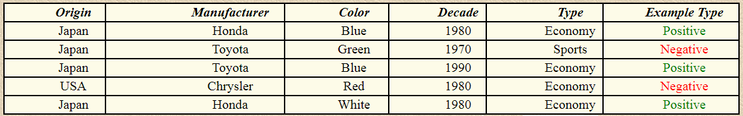
Problem 1:
Learning the concept of "Japanese Economy Car"
Features: ( Country of Origin, Manufacturer, Color, Decade, Type )

Slide 88
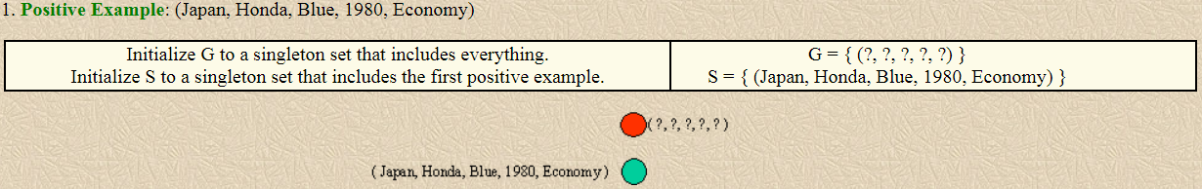

Slide 89
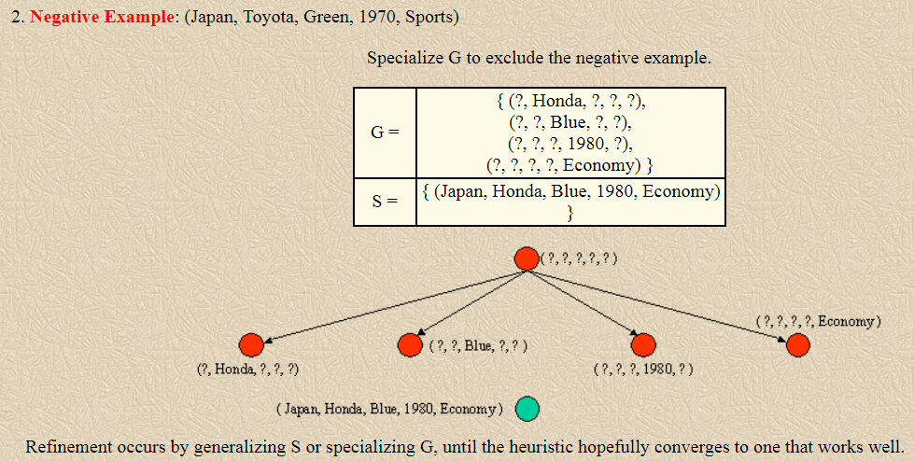

Slide 90
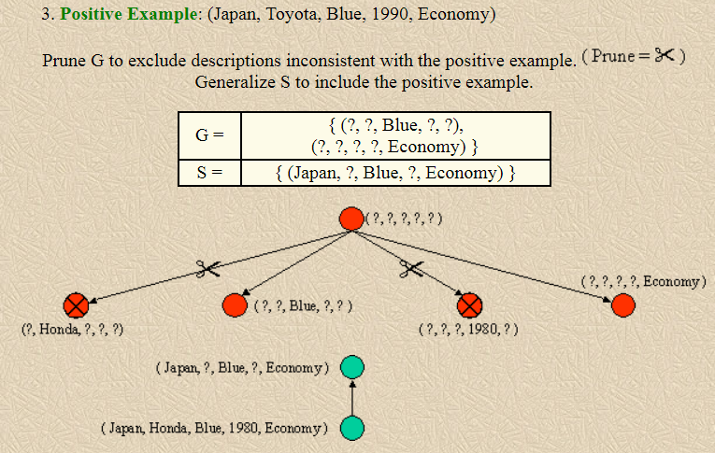

Slide 91
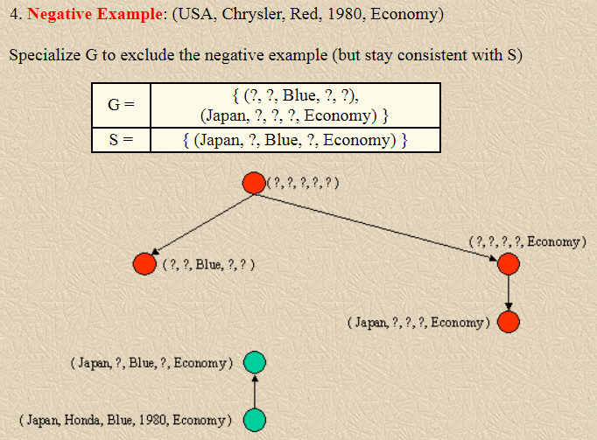

Slide 92
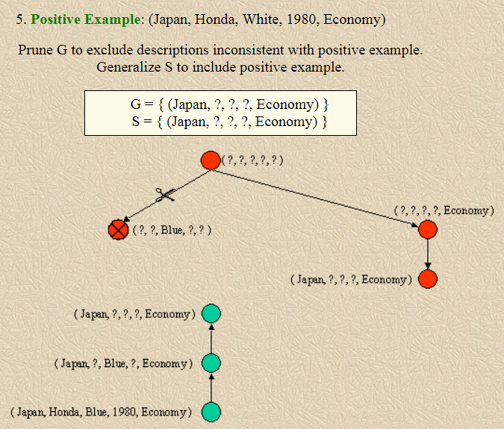

Slide 93
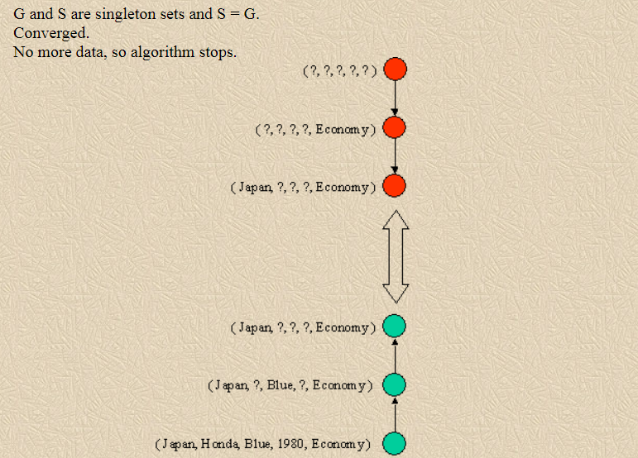

Slide 94
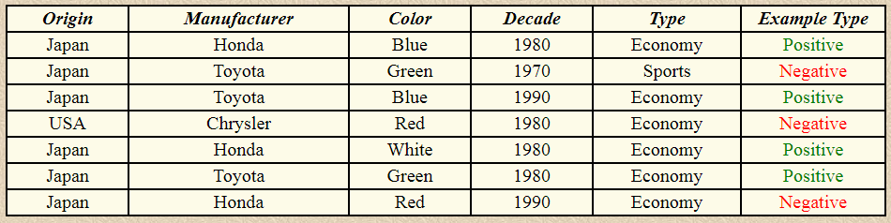
Problem 2:
Learning the concept of "Japanese Economy Car" (continued)
Features: ( Origin, Manufacturer, Color, Decade, Type )

Slide 95
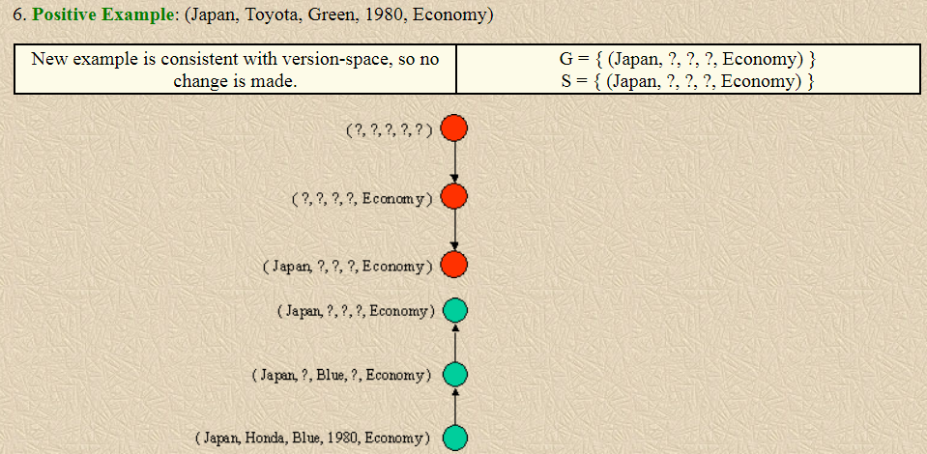

Slide 96
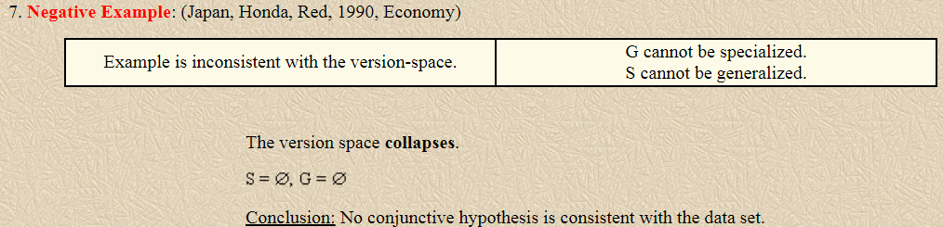

Slide 97
Inductive Bias
The fundamental questions for inductive inference
What if the target concept is not contained in the hypothesis space?
Can we avoid this difficulty by using a hypothesis space that includes every possible hypothesis?
How does the size of this hypothesis space influence the ability of the algorithm to generalize to unobserved instances?
How does the size of the hypothesis space influence the number of training examples that must be observed?

Slide 98
Effect of incomplete hypothesis space
Preceding algorithms work if target function is in H and will ill generally not work if target function not in H
Consider following examples which represent target function “sky = sunny or sky = cloudy”:
〈Sunny Warm Normal Strong Cool Change〉 Y
〈Cloudy Warm Normal Strong Cool Change〉 Y
〈Rainy Warm Normal Strong Cool Change〉 N
If apply Candidate Elimination algorithm as before, end up with empty Version Space
After first two training example
S= 〈? Warm Normal Strong Cool Change〉
New hypothesis is overly general and it covers the third negative training example!. Our H does not include the appropriate c.
The problem is that we have biased the learner to consider only conjunctive hypotheses. In this case we require a more expressive hypothesis space.

Slide 99
An Unbiased Learner
2. Can we avoid this difficulty by using a hypothesis space that includes every possible hypothesis?
Incomplete hypothesis space
If c not in H, then consider generalizing representation of H to contain c
The size of the instance space X of days described by the six available attributes is 96. The number of distinct subsets that can be defined over a set X containing |X| elements (i.e., the size of the power set of X) is 2^{|X|}
Recall that there are 96 instances in EnjoySport; hence there are 2⁹⁶ possible hypotheses in full space H
Can do this by using full propositional calculus with AND, OR, NOT
Hence H defined only by conjunctions of attributes is biased (containing only 973 h’s)

Slide 100
Let us reformulate the Enjoysport learning task in an unbiased way by defining a new hypothesis space H' that can represent every subset of instances; that is, let H' correspond to the power set of X.
One way to define such an H' is to allow arbitrary disjunctions, conjunctions, and negations of our earlier hypotheses.
For instance, the target concept "Sky = Sunny or Sky = Cloudy" could then be described as
(Sunny, ?, ?, ?, ?, ?) V (Cloudy, ?, ?, ?, ?, ?)
Given this hypothesis space, we can safely use the CANDIDATE-ELIMINATION algorithm without worrying that the target concept might not be expressible but this hypothesis raises a new, equally difficult problem that is our concept learning algorithm is now completely unable to generalize beyond the observed examples

Slide 101
Suppose we present three positive examples (xl, x2, x3)and two negative examples (x4, x5) to the learner. At this point, the S boundary of the version space will contain the hypothesis which is just the disjunction of the positive examples
S : {(xl V x2 V x3)}
because this is the most specific possible hypothesis that covers these three examples. Similarly, the G boundary will consist of the hypothesis that rules out only the observed negative examples
G : {¬ (x4 V x5 ) }
The problem here is that with this very expressive hypothesis representation, the S boundary will always be simply the disjunction of the observed positive examples, while the G boundary will always be the negated disjunction of the observed negative examples. Therefore, the only examples that will be unambiguously classified by S and G are the observed training examples themselves. In order to converge to a single, final target concept, we will have to present every single instance in X as a training example!

Slide 102
The Futility of Bias-Free Learning
A fundamental property of inductive inference: a learner that makes no a priori assumptions regarding the identity of the target concept has no rational basis for classifying any unseen instances
CANDIDATE-ELIMINATION algorithm was able to generalize beyond the observed training examples in EnjoySport task is that it was biased by the implicit assumption that the target concept could be represented by a conjunction of attribute values.
In cases where this assumption is correct, its classification of new instances will also be correct.
If this assumption is incorrect, it is certain that the CANDIDATE-ELIMINATION algorithm will misclassify at least some instances from X.

Slide 103
Inductive learning requires some form of prior assumptions, or inductive bias
The key idea is to capture here is the policy by which the learner generalizes beyond the observed training data, to infer the classification of new instances.

Slide 104
Definition:
Consider a concept learning algorithm L for the set of instances X.
Let c be an arbitrary concept defined over X
Let D_{c} = {( x , c(x))} be an arbitrary set of training examples of c.
Let L(x_{i}, D_{c}) denote the classification assigned to the instance x_{i} by L after training on the data D_{c}.
The inductive bias of L is any minimal set of assertions B such that for any target concept c and corresponding training examples D_{c}
(∀ x_{i} ∈ X ) [(B ∧ D_{c} ∧ x_{i}) ├ L(x_{i}, D_{c})]

Slide 105
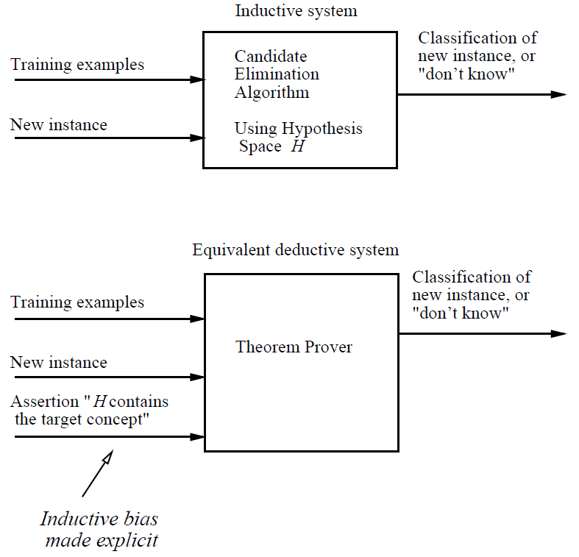
Modelling inductive systems by equivalent deductive systems.
The input-output behavior of the
CANDIDATE-ELIMINATION algorithm using a hypothesis space H is identical to that of a deductive
theorem prover utilizing the assertion (statement of fact) "H contains the target concept." This assertion is therefore called the inductive bias of the CANDIDATE-ELIMINATION algorithm. characterizing inductive systems by their inductive bias allows modelling them by their equivalent deductive systems. This provides a way to compare inductive systems according to their policies for generalizing beyond the observed
training data.

